Slide 1
Cloud 2 Leading the Enterprise Mobile Revolution
Sean Whiteley
Vice President, Product Marketing
salesforce.com
Notes:
Thanks so much for having us to London. Great London-based team, great customers

Slide 2
Safe Harbor
Safe harbor statement under the Private Securities Litigation Reform Act of 1995: This presentation may contain forward-looking statements that involve risks, uncertainties, and assumptions. If any such uncertainties materialize or if any of the assumptions proves incorrect, the results of salesforce.com, inc. could differ materially from the results expressed or implied by the forward-looking statements we make. All statements other than statements of historical fact could be deemed forward-looking, including any projections of subscriber growth, earnings, revenues, or other financial items and any statements regarding strategies or plans of management for future operations, statements of belief, any statements concerning new, planned, or upgraded services or technology developments and customer contracts or use of our services.
The risks and uncertainties referred to above include – but are not limited to – risks associated with developing and delivering new functionality for our service, our new business model, our past operating losses, possible fluctuations in our operating results and rate of growth, interruptions or delays in our Web hosting, breach of our security measures, the immature market in which we operate, our relatively limited operating history, our ability to expand, retain, and motivate our employees and manage our growth, new releases of our service and successful customer deployment, our limited history reselling non-salesforce.com products, and utilization and selling to larger enterprise customers. Further information on potential factors that could affect the financial results of salesforce.com, inc. is included in our annual report on Form 10-K filed and our quarterly report for the most recent fiscal quarter ended July 31, 2008. These documents are available on the SEC Filings section of the Investor Information section of our Web site.
Any unreleased services or features referenced in this or other press releases or public statements are not currently available and may not be delivered on time or at all. Customers who purchase our services should make the purchase decisions based upon features that are currently available. Salesforce.com, inc. assumes no obligation and does not intend to update these forward-looking statements.
Notes:
Make your purchasing decisions on currently available products only.

Slide 3

Agenda
Cloud 2 and the Enterprise Mobile Revolution
Cloud 2 and the Enterprise Mobile Revolution
Mobile Product Discussion
Mobile CRM at Websense
Sean Whiteley
Vice President of Product Marketing at Salesforce.com
Sean Whiteley
Vice President of Product Marketing at Salesforce.com
Mobile Product Discussion
Bing Yang
Senior Product Marketing Manager at Salesforce.com
Bing Yang
Senior Product Marketing Manager at Salesforce.com
websense: Mobile CRM
Werner Schmidt
Sales Operations Director at Websense
Werner Schmidt
Sales Operations Director at Websense
Notes:
Bing and Werner

Slide 4



Shibuya Epiphany
Notes:
Shibuya Crossing is outside the Shibuya train station in the financial district of Tokyo. It is said to have the densest mobile traffic in the world. It was here, one day in early 2000, that Howard Reinghold had what he refers to has his “shibuya epiphany”, which inspired him to write the book smart mobs which was published in 2003.

Slide 5

Shibuya Crossing
A phone is not just a phone anymore
Notes:
His “epiphany” was that a phone was not just a phone anymore. People were not talking on their phones, but texting, typing, and reading. One of the things he talked about in his book was NTT Docomo and i-mode. This division’s goal was to start acting less like a traditional telco, and begin operating more like a web company.

Slide 6
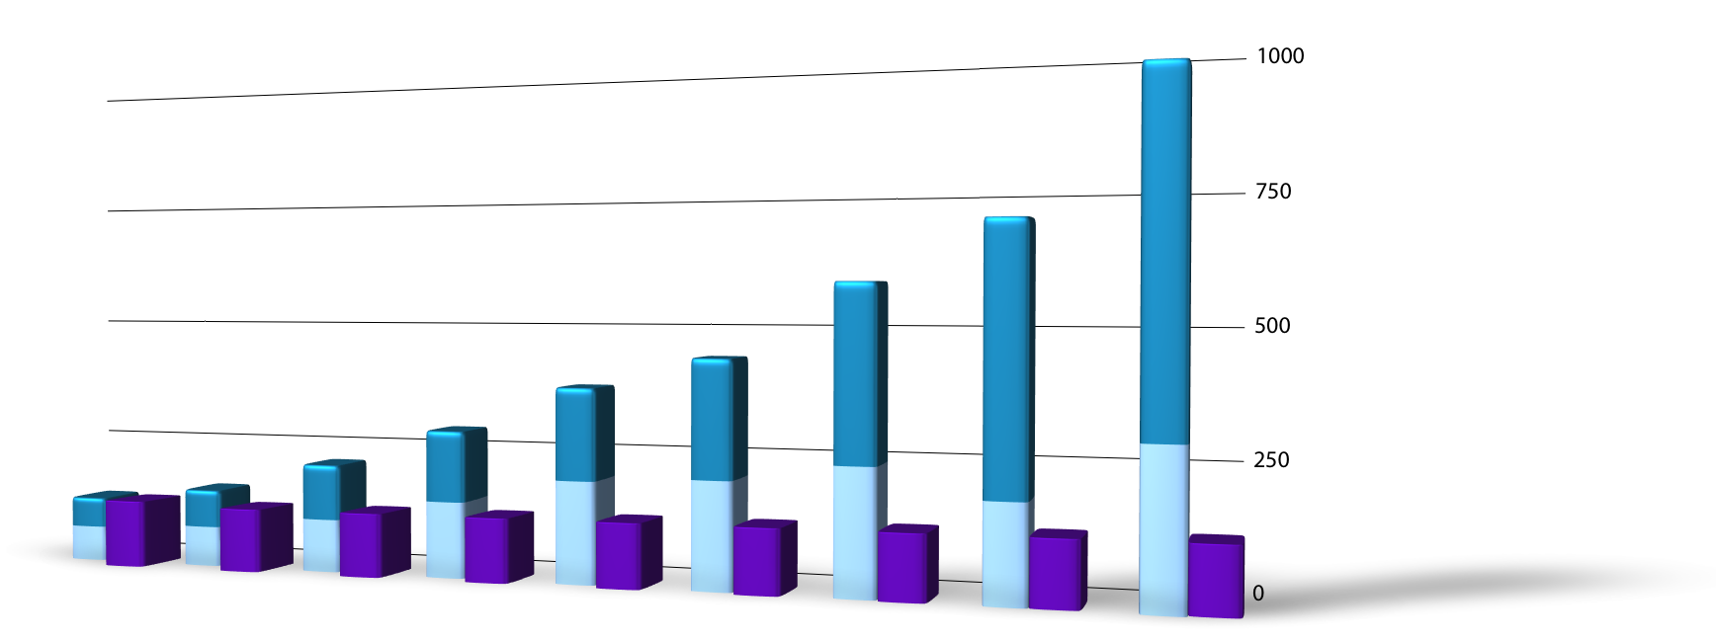
10 years later, next-gen devices are redefining how we use the Web
Device Shipments
Smartphones
Annual Unit Shipments (MM)
Notebook PCs
Desktop
2005
2006
2007
2008
2009E
2010E
2011E
2012E
2013E
Notes:
Not only are the content and applications that are different today, but how people access these applications is also different.
Instead of accessing these social networking apps from their desktop, people are using smartphones like the iphones, blackberry and a host of new devices like the ipad to access the internet.
These new devices make it faster and easier to access the

Slide 7
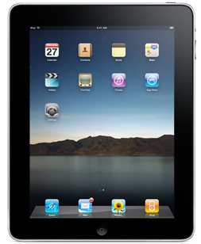
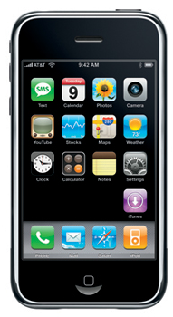
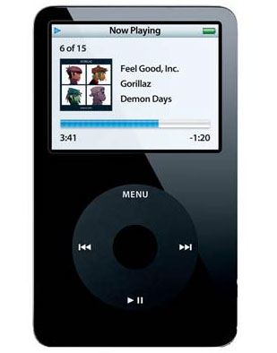
With Apple leading the way…
It took Apple 28 days to sell a million iPads
Time to sell 1 million units in days
28
~360
74
Notes:
http://techcrunch.com/2010/07/06/freelancer-geolocation-html5-jobs/

Slide 8
A new standard has been set for mobile experiences
Always connected
Simple install/uninstall
Easy to use
Geo-aware
Affordable
Fast
Fun
909% increase in geolocation jobs online
http://techcrunch.com/2010/07/06/freelancer-geolocation-html5-jobs/
3G coverage to hit 21% this year globally
- JP is at 96%
- UK is at 54%
- US is at 46%
Morgan Stanley’s Mobile Internet Report, published 12/15/09 (available at www.ms.com/techresearch).
Notes:
http://techcrunch.com/2010/07/06/freelancer-geolocation-html5-jobs/

Slide 9
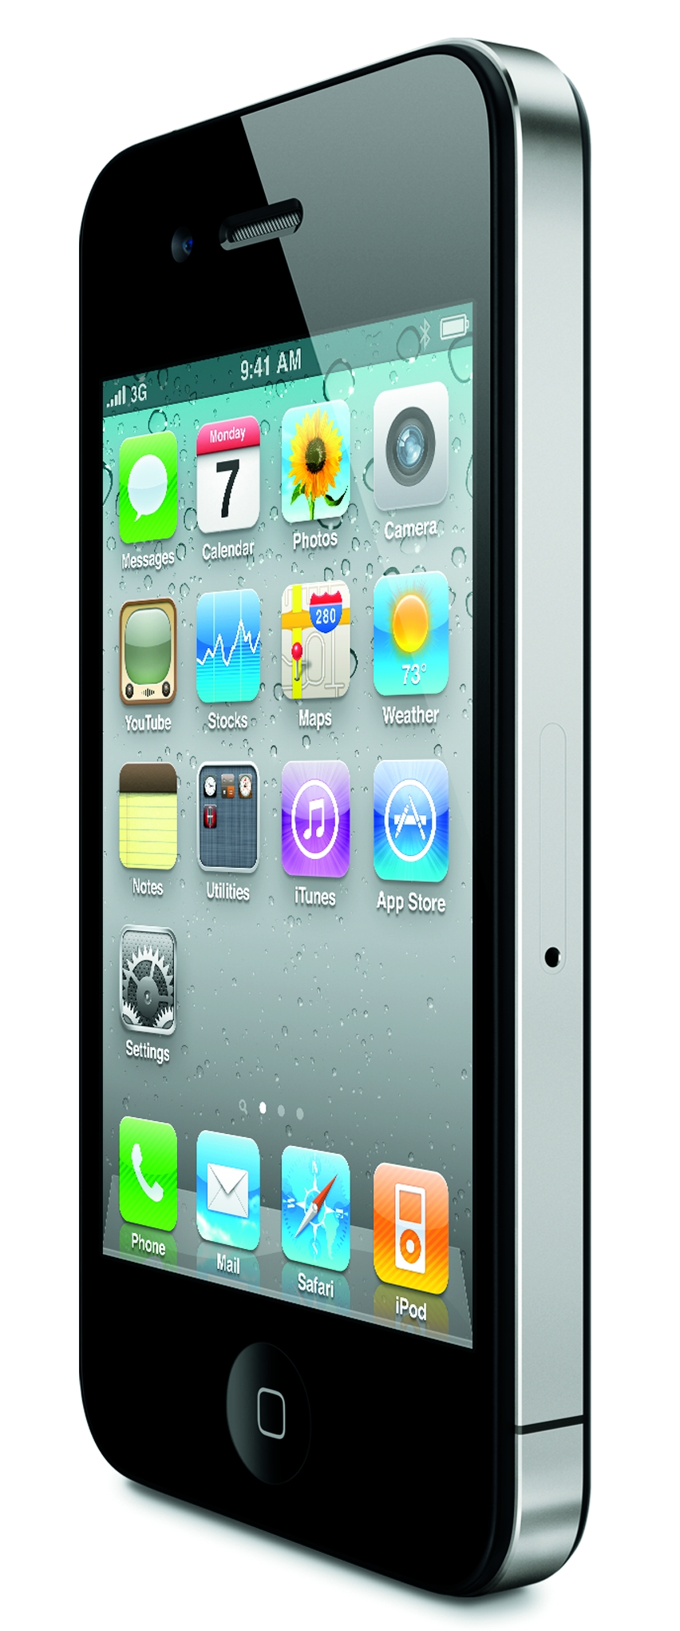
As a result, consumer usage has skyrocketed
In 2009 alone…
Half a billion
$1 billion in orders
25 million people (+112%)
4.7 million people (+347%)
3 billion apps
people accessed the mobile web
were placed on Amazon via mobile devices
accessed Facebook through a mobile browser
accessed Twitter through a mobile browser
downloaded from App Store
Comscore, January 2010

Slide 10
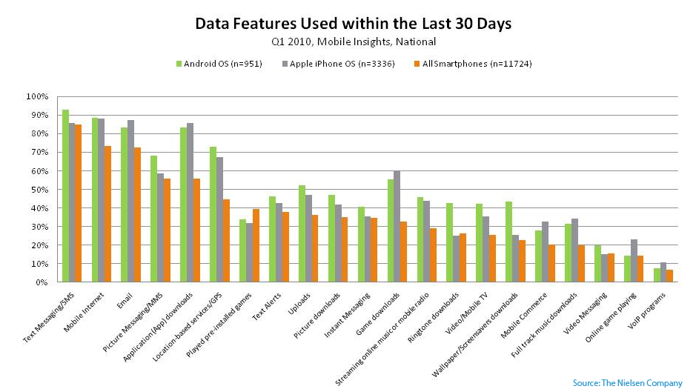

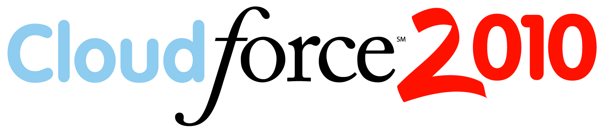
So what are people doing on these devices?
1 SMS
2 Mobile Web
* Data features only
3 Email
4 Pictures
5 Apps
6 Location-based
IDC (December 2009)
Notes:
The most popular activities of mobile Internet users, according to IDC (December 2009) are:
* Using search engines, reading news and sports information, downloading music and videos, and sending/receiving email and instant messages. Over the next four years, IDC predicts the fastest growing activities will be purchasing, social networking and blogging.
* Accessing online business applications and corporate email systems will also grow rapidly.

Slide 11
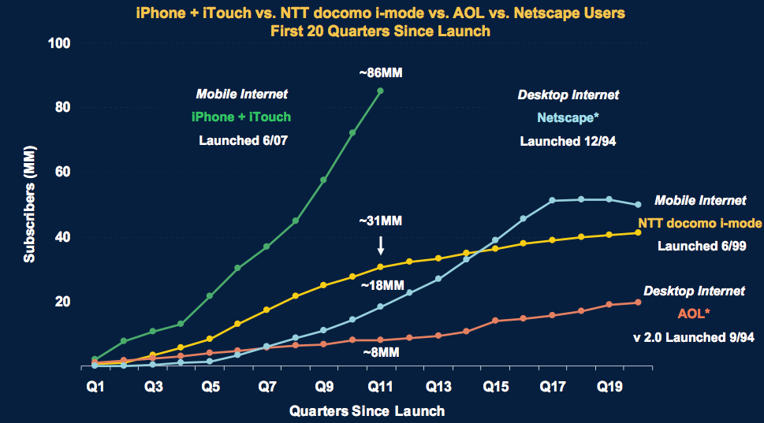
Mobile Web ramping faster than Desktop Internet
Morgan Stanley’s analysts believe that, based on the current rate of change and adoption, the mobile web will be bigger than desktop Internet use by 2015.
Morgan Stanley’s Mobile Internet Report, published 12/15/09 (available at www.ms.com/techresearch).
Notes:
This is from a study performed by Morgan Stanley just before last Christmas. At our worldwide management offsite, our CEO marc benioff gave every person a copy. I now know why he did it.
It took AOL more than a decade to reach 30 million subscribers. NTT docomo I-mode did it in just over 2 years.
One of the keys to this huge growth is social networking

Slide 12
2009: Social Networking Surpasses Email
Inflection Point
Global Users (MM)
Social Networking Users
Email Users
Morgan Stanley’s Mobile Internet Report, published 12/15/09 (available at www.ms.com/techresearch).

Slide 13



Social Networking + Mobile =
150 Million mobile app users
Users 2X more active on mobile
http://www.facebook.com/press/info.php?statistics
Mobile usage up 62% in last 4 months
16% of signups from mobile device
http://blog.twitter.com/2010/09/evolving-ecosystem.html

Slide 14
Facebook dominates UK mobile use
F
Mobile Minutes Spent Online in the UK
Facebook | 2.2 billion minutes
Google sites | 395 million minutes
Microsoft sites | 165 million minutes
Orange sites | 138 million minutes
AOL (and Bebo) | 106 million minutes
Vodafone | 104 million minutes
BBC sites | 89 million minutes
Flirtomatic | 83 million minutes
Yahoo sites | 48 million minutes
Source: GSMA/Comscore
acebook
accounts for nearly half of all the time people in the UK spend going online using their phones.

Slide 15


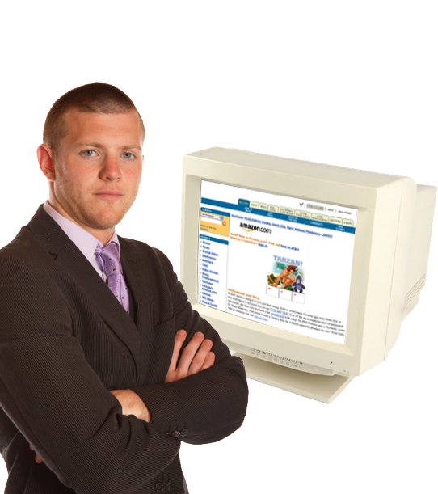
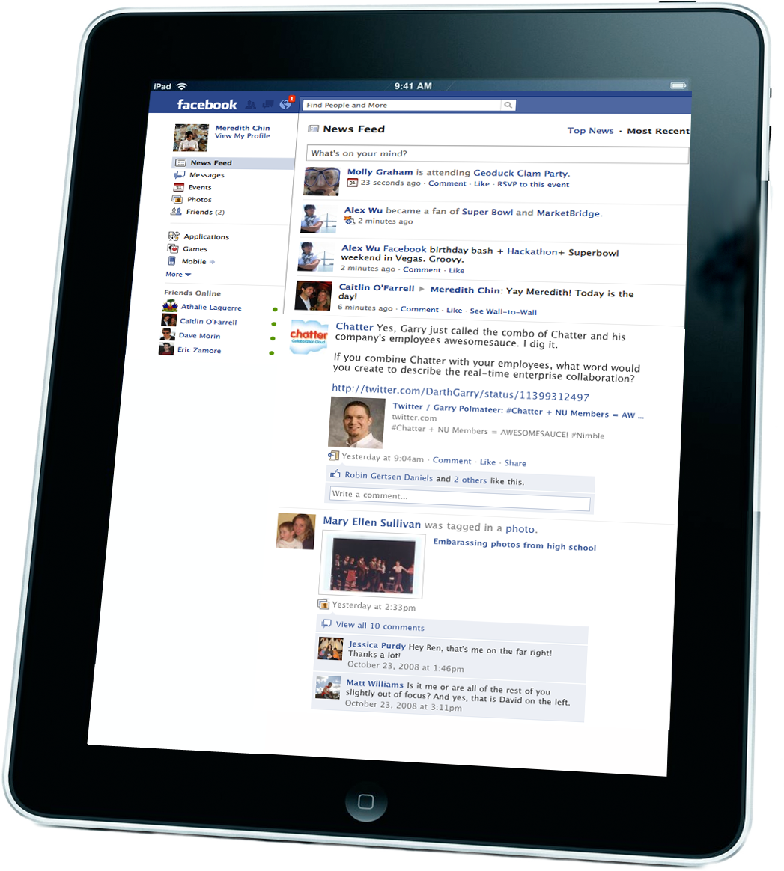

It’s not just the consumer Web that is changing
2000
2010
Amazon.com
Tabs
Pull
Click
Desktop
Fixed
Location Unknown
Windows/Mac
Facebook
Feeds
Push
Touch
Smartphone/Tablet
Mobile
Location Aware
Cocoa/HTML 5

Slide 16
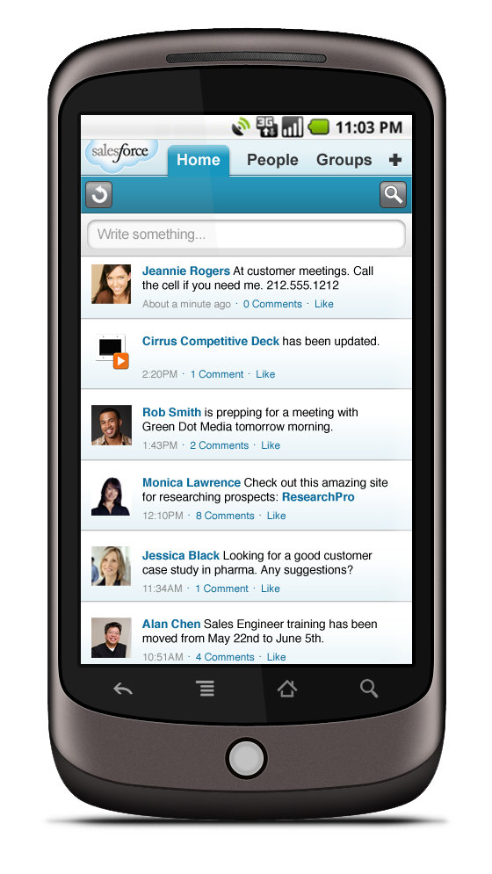
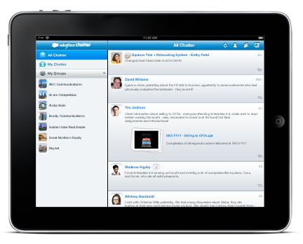


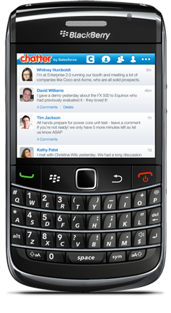
Chatter Mobile: A new enterprise app experience
Feeds, Posts, Comments, Profiles
Will Work With iPhone, iPad, BlackBerry
Android Coming Early 2011
Notes:
We’ve brought the best of the consumer Web to the Enterprise

Slide 17
Mobile Product Discussion
Bing Yang
Senior Product Marketing Manager at Salesforce.com

Slide 18

What Makes a Great Mobile App?

Slide 19
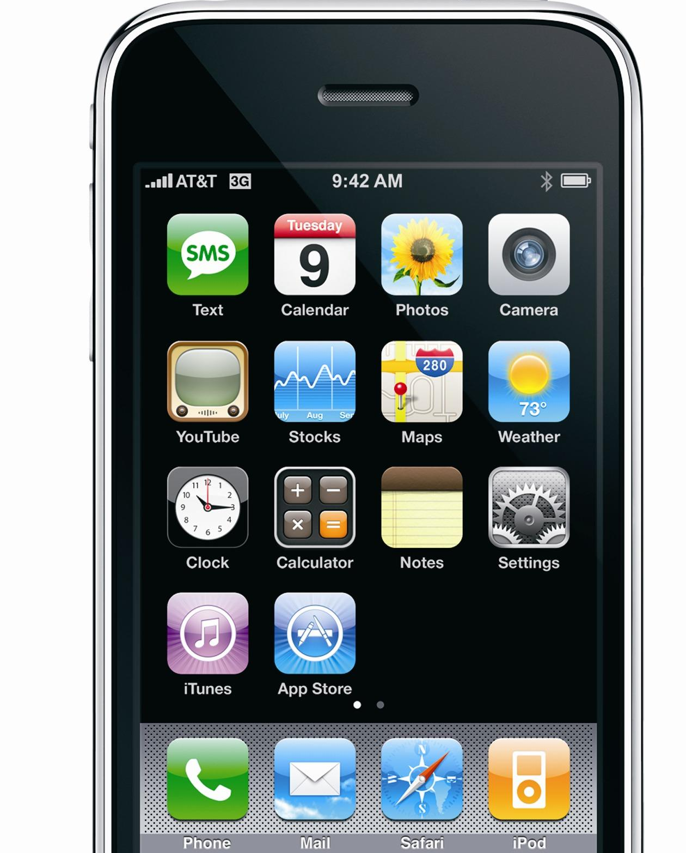
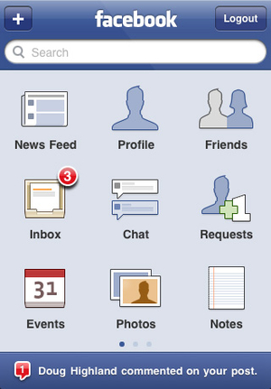
What Makes a Great Mobile App?
Useful on the go
Relevant all the time, wherever you are

Slide 20
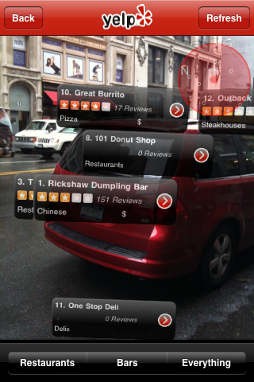
What Makes a Great Mobile App?
Useful on the go
Relevant all the time, wherever you are
Great mobile features
Camera, GPS, Compass, Voice, Touch

Slide 21
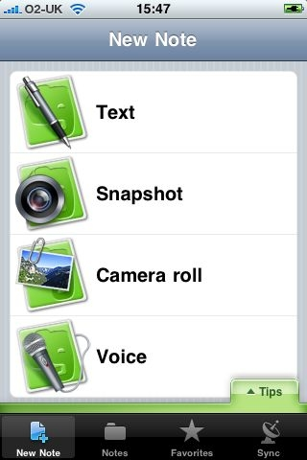
What Makes a Great Mobile App?
Useful on the go
Relevant all the time, wherever you are
Great mobile features
Camera, GPS, Compass, Voice, Touch
Built on the Cloud
“A million servers in the palm of your hand”

Slide 22


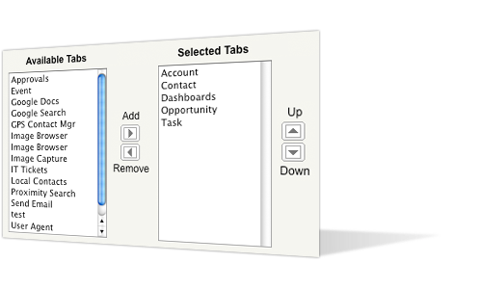





Two Great Mobile Options from salesforce.com
MOBILE – FULL VERSION
Standard Objects | Customizations | Content Library | Full Management Console
Accounts Contacts Etc. | Expense Reporting Visualforce pages Etc.
MOBILE LITE (FREE)
Standard Objects | Custom Objects | Content Library | Full Management Console
Accounts Contacts Etc. | Not Available | Not Available | Limited Configurability
Notes:
Salesforce.com offers two great options for mobile users.
The first option is Mobile Lite, which is free for all editions of Salesforce starting with Contact Manager Edition. Mobile Lite offers full read/write access to standard Salesforce objects – things like leads, contacts, and opportunities.
Mobile Lite is a great way to get started with the mobile product.
The second available option is the full version of mobile. This robust, highly configurable application offers users the most advanced and productive mobile experience.
With the full version, users enjoy mobile access to Content, custom applications, 3rd party apps like those from AppExchange, Visualforce pages, and much more.
The full version mobile product is included in the Unlimited Edition subscription package and is also available for a fee as an add-one license for Professional and Enterprise Edition customers.

Slide 23
Chatter Mobile – Coming Soon!

Slide 24
websense
Werner Schmidt
Sales Operations Director at websense

Slide 25

Salesforce.com & Mobile
We have over 70% of our company now using Salesforce.com across almost all departments, 30% are sales and of those 50% are now using mobile.
The main areas of use are;
Account Information
Contact Information
Marketing Intelligence
Opportunity Info including product information
Leads

Slide 26
Why we like Salesforce.com Mobile
Improved Productivity
Time – No having to start up your laptop and find a wireless connection!
Accurate and latest information before arriving at the customer
Updates on the go
Contacts and address information instead of waiting to get home
Opportunities with the latest notes without missing anything!

Slide 27
Q & A

Slide 28


Slide 29
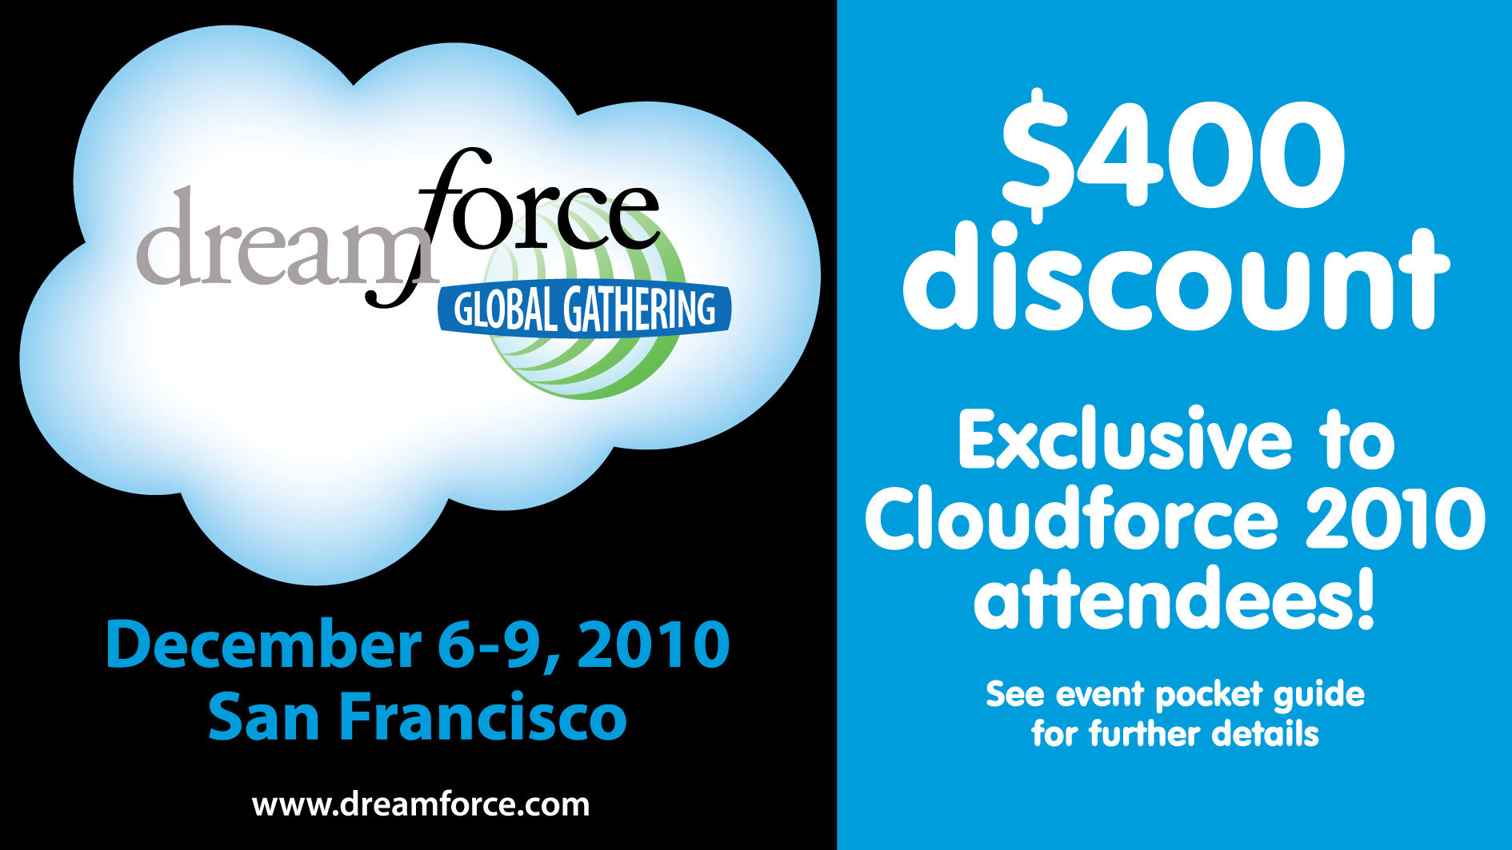

Slide 30


Slide 31


